Slide 1


Klik op uw account.
Uitschakelen

WereldWijd
Maurice v.L
Henri Stok
Jan Heikens
H. Heikens
C. Heikens
E. Heikens
D. Heikens
WereldWijd coöperatie

Slide 2
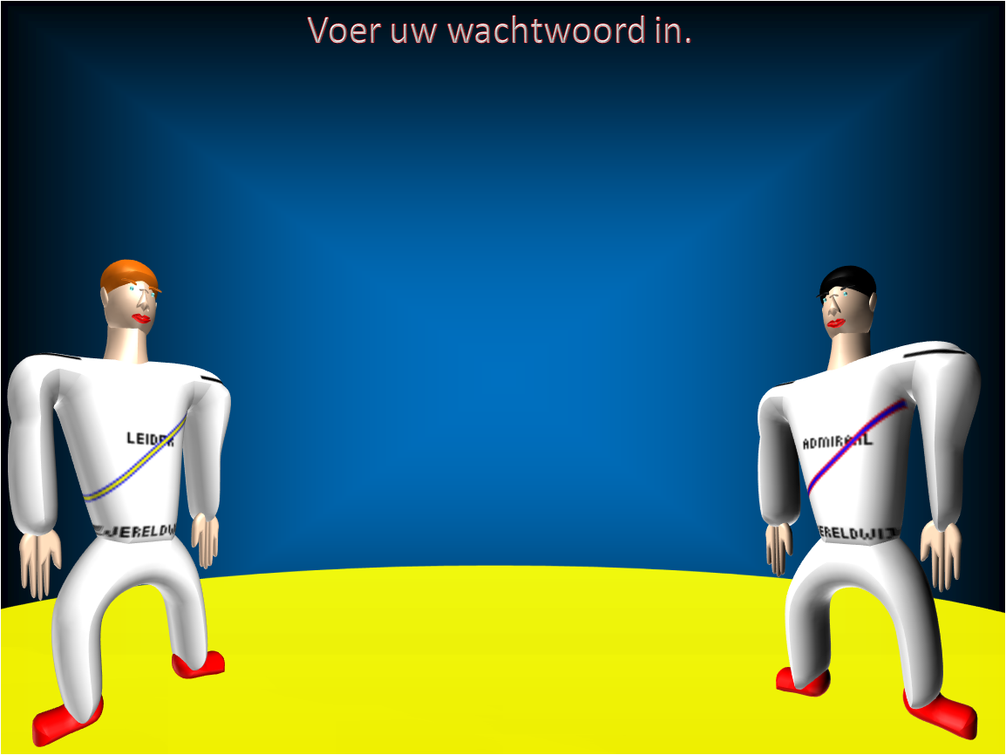

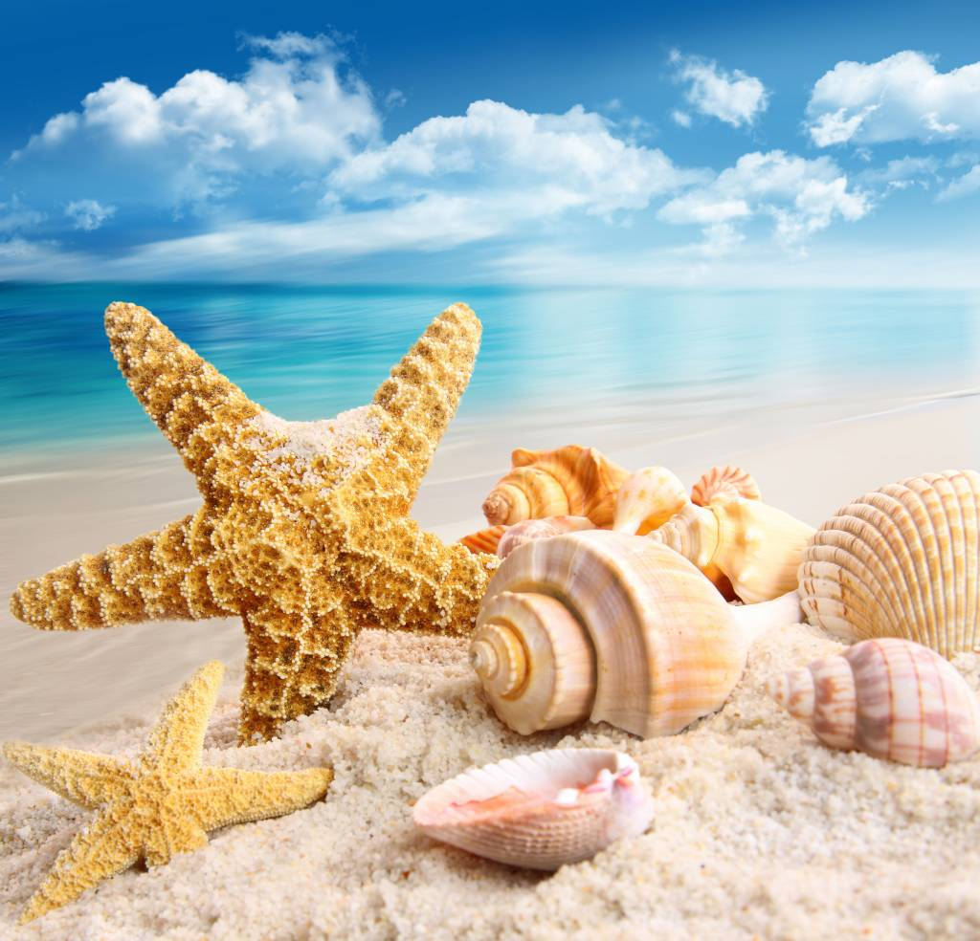
Jan
Jan Heikens
R
WereldWijd
✓ Internet
 Google Chrome
 Verkenner
 Filmmaker
 Rekenmachine
a
a
a
a
a
a
a
a
a
a
a
a
a
b
b
b
a
b
b
b
b
b
b
b
b
c
c
c
c
c
c
c
c
c
c
a
c
d
a
a
a
a
a
a
a
a
a
a
a
a
e
b
a
b
b
b
b
a
b
b
b
b
b
a
f
c
c
c
c
c
c
c
c
a
c
c
g
a
a
a
a
a
a
a
a
a
a
h
b
b
b
b
b
b
b
b
b
b
i
c
c
c
c
c
c
c
c
c
c
j
a
a
a
a
a
a
a
a
a
a
k
b
b
b
b
b
b
b
b
b
b
l
c
c
c
c
c
c
c
c
c
c
m
c
c
c
c
c
c
c
c
c
c
 Paint
n
d
d
d
d
d
d
d
d
d
d
o
e
e
e
e
e
e
e
e
e
e
p
f
f
f
f
f
f
f
f
f
f
q
d
d
d
d
d
d
d
d
d
d
r
e
e
e
e
e
e
e
e
e
e
s
f
f
f
f
f
f
f
f
f
f
t
d
d
d
d
d
d
d
d
d
d
u
e
e
e
e
e
e
e
e
e
e
v
f
f
f
f
f
f
f
f
f
f
w
d
d
d
d
d
d
d
d
d
d
x
e
e
e
e
e
e
e
e
e
e
y
f
f
f
f
f
f
f
f
f
f
z
f
f
f
f
f
f
f
f
f
f
 Wordpad
↑ C schoonmaker
Uitschakelen

Afmelden
−

WereldWijd


?

Slide 3
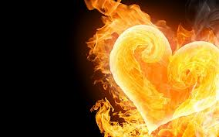

Hennie
Hennie
WereldWijd
✓ Internet
 Google Chrome
 Verkenner
 Filmmaker
 Rekenmachine
a
a
a
a
a
a
a
a
a
a
a
b
b
b
b
b
b
b
b
b
b
b
c
c
c
c
c
c
c
c
c
c
c
d
a
a
a
a
a
a
a
a
a
a
e
b
b
a
b
b
b
a
b
b
b
b
b
f
c
c
c
c
c
c
c
c
c
c
g
a
a
a
a
a
a
a
a
a
a
h
b
a
b
b
b
a
b
b
b
b
b
b
i
c
c
c
c
c
c
c
c
c
c
j
a
a
a
a
a
a
a
a
a
a
k
b
b
b
b
b
b
b
b
b
b
l
c
c
c
c
c
c
c
c
c
c
m
c
c
c
c
c
c
c
c
c
a
a
a
c
 Paint
n
d
d
d
d
d
d
d
d
d
d
o
e
e
e
e
e
e
e
e
e
e
p
f
f
f
f
f
f
f
f
f
f
q
d
d
d
d
d
d
d
d
d
d
r
e
e
e
e
e
e
e
e
e
e
s
f
f
f
f
f
f
f
f
f
f
t
d
d
d
d
d
d
d
d
d
d
u
e
e
e
e
e
e
e
e
e
e
v
f
f
f
f
f
f
f
f
f
f
w
d
d
d
d
d
d
d
d
d
d
x
e
e
e
e
e
e
e
e
e
e
y
f
f
f
f
f
f
f
f
f
f
z
f
f
f
f
f
f
f
f
f
a
f
a
a
 Wordpad
↑ C schoonmaker
Uitschakelen

Afmelden
−

WereldWijd


?

Slide 4

Corné
Corné
WereldWijd
✓ Internet
 Google Chrome
 Verkenner
 Filmmaker
 Rekenmachine
a
a
a
a
a
a
a
a
a
a
a
b
b
b
b
b
b
b
b
b
b
b
c
c
c
c
c
c
c
c
c
c
c
d
a
a
a
a
a
a
a
a
a
a
e
b
b
b
b
b
b
b
b
b
a
b
f
c
c
c
c
c
c
c
c
c
c
g
a
a
a
a
a
a
a
a
a
a
h
b
b
b
b
b
b
b
b
b
b
i
c
c
c
c
c
c
c
c
c
c
j
a
a
a
a
a
a
a
a
a
a
k
b
b
b
b
b
b
b
b
b
b
l
c
c
c
c
c
c
c
c
c
c
m
c
c
c
c
c
c
c
c
c
a
a
a
a
a
c
 Paint
n
d
d
d
d
d
d
d
d
d
d
o
e
e
e
e
e
e
e
e
e
e
p
f
f
f
f
f
f
f
f
f
f
q
d
d
d
d
d
d
d
d
d
d
r
e
e
e
e
e
e
e
e
e
e
s
f
f
f
f
f
f
f
f
f
f
t
d
d
d
d
d
d
d
d
d
d
u
e
e
e
e
e
e
e
e
e
e
v
f
f
f
f
f
f
f
f
f
f
w
d
d
d
d
d
d
d
d
d
d
x
e
e
e
e
e
e
e
e
e
e
y
f
f
f
f
f
f
f
f
f
f
z
f
f
f
f
f
f
f
f
f
a
a
a
a
f
 Wordpad
↑ C schoonmaker
Uitschakelen

Afmelden
−

WereldWijd


?

Slide 5
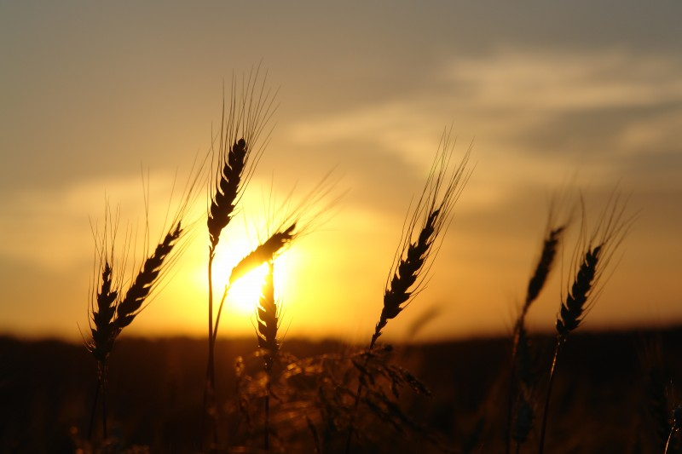



Dirk-Johan
Dirk-Johan
R
WereldWijd
✓ Internet
 Google Chrome
 Verkenner
 Filmmaker
 Rekenmachine
a
a
a
a
a
a
a
a
a
a
a
a
b
b
b
b
b
b
b
b
b
b
b
c
c
c
c
c
c
c
c
c
c
c
d
a
a
a
a
a
a
a
a
a
a
a
e
b
b
b
b
b
b
b
b
b
b
f
c
c
c
c
c
c
c
c
c
c
g
a
a
a
a
a
a
a
a
a
a
h
b
a
b
b
b
b
b
b
b
a
b
b
i
c
c
c
a
c
c
c
c
c
c
c
j
a
a
a
a
a
a
a
a
a
a
a
k
b
b
b
b
b
a
b
b
b
b
b
l
c
c
c
c
c
c
c
c
c
c
m
c
c
c
c
c
c
c
c
c
c
 Paint
n
d
d
d
d
d
d
d
d
d
d
o
e
e
e
e
e
e
e
e
e
e
p
f
f
f
f
f
f
f
f
f
f
q
d
d
d
d
d
d
d
d
d
d
r
e
e
e
e
e
e
e
e
e
e
s
f
f
f
f
f
f
f
f
f
f
t
d
d
d
d
d
d
d
d
d
d
u
e
e
e
e
e
e
e
e
e
e
v
f
f
f
f
f
f
f
f
f
f
w
d
d
d
d
d
d
d
d
d
d
x
e
e
e
e
e
e
e
e
e
e
y
f
f
f
f
f
f
f
f
f
f
z
f
f
f
f
f
f
f
f
f
a
a
a
f
 Wordpad
↑ C schoonmaker
Uitschakelen

Afmelden
−

WereldWijd


?

Slide 6
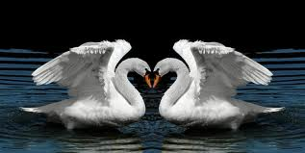
Elias
Elias
R
WereldWijd
✓ Internet
 Google Chrome
 Verkenner
 Filmmaker
 Rekenmachine
a
a
a
a
a
a
a
a
a
b
b
b
b
b
b
b
b
b
c
c
c
c
c
c
c
c
c
d
a
a
a
a
a
a
a
a
e
b
a
b
a
b
b
b
b
b
b
a
f
c
c
c
c
c
c
c
c
g
a
a
a
a
a
a
a
a
h
b
b
b
b
b
b
b
b
i
c
c
c
c
c
c
c
c
j
a
a
a
a
a
a
a
a
k
b
b
b
b
b
b
b
b
l
c
c
c
c
c
c
c
c
m
c
c
c
c
c
c
c
a
c
a
 Paint
n
d
d
d
d
d
d
d
d
o
e
e
e
e
e
e
e
e
p
f
f
f
f
f
f
f
f
q
d
d
d
d
d
d
d
d
r
e
e
e
e
e
e
e
e
s
f
f
f
f
f
f
f
f
t
d
d
d
d
d
d
d
d
u
e
e
e
e
e
e
e
e
v
f
f
f
f
f
f
f
f
w
d
d
d
d
d
d
d
d
x
e
e
e
e
e
e
e
e
y
f
f
f
f
f
f
f
f
z
f
f
f
f
f
f
f
a
f
a
a
 Wordpad
↑ C schoonmaker
Uitschakelen

Afmelden
−

WereldWijd


?

Slide 7
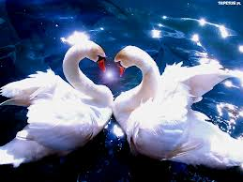
Henri
Henri
WereldWijd
✓ Internet
 Google Chrome
 Verkenner
 Filmmaker
 Rekenmachine
a
a
a
a
a
a
a
a
a
a
a
b
b
b
b
b
b
b
b
b
b
b
c
c
c
c
c
c
c
c
c
c
c
d
a
a
a
a
a
a
a
a
a
a
e
b
b
b
b
b
b
b
b
a
b
b
f
c
c
c
c
c
c
c
c
c
c
g
a
a
a
a
a
a
a
a
a
a
h
b
b
b
b
b
b
b
b
b
b
i
c
c
c
a
c
a
c
c
c
c
c
c
j
a
a
a
a
a
a
a
a
a
a
k
b
b
b
b
b
b
b
b
b
b
l
c
c
c
c
c
c
c
c
c
c
m
c
c
c
c
c
c
c
c
c
a
c
 Paint
n
d
d
d
d
d
d
d
d
d
d
o
e
e
e
e
e
e
e
e
e
e
p
f
f
f
f
f
f
f
f
f
f
q
d
d
d
d
d
d
d
d
d
d
r
e
e
e
e
e
e
e
e
e
e
s
f
f
f
f
f
f
f
f
f
f
t
d
d
d
d
d
d
d
d
d
d
u
e
e
e
e
e
e
e
e
e
e
v
f
f
f
f
f
f
f
f
f
f
w
d
d
d
d
d
d
d
d
d
d
x
e
e
e
e
e
e
e
e
e
e
y
f
f
f
f
f
f
f
f
f
f
z
f
f
f
f
f
f
f
f
f
a
a
a
a
a
a
f
 Wordpad
↑ C schoonmaker
Uitschakelen

Afmelden
−

WereldWijd


?

Slide 8
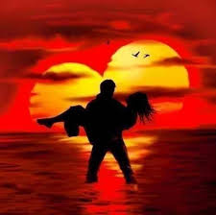
Maurice
Maurice
WereldWijd
✓ Internet
 Google Chrome
 Verkenner
 Filmmaker
 Rekenmachine
a
a
a
a
a
a
a
a
a
a
b
b
b
b
b
b
b
b
b
b
c
c
c
c
c
c
c
c
c
c
d
a
a
a
a
a
a
a
a
a
a
e
b
b
a
b
b
a
b
b
b
b
b
f
c
a
c
c
c
c
c
c
c
c
g
a
a
a
a
a
a
a
a
a
h
b
b
b
b
b
b
b
b
b
i
c
c
c
c
c
c
c
c
c
j
a
a
a
a
a
a
a
a
a
k
b
b
b
b
b
b
b
b
b
l
c
c
c
c
c
c
c
c
c
m
c
c
c
c
c
c
c
c
c
 Paint
n
d
d
d
d
d
d
d
d
d
o
e
e
e
e
e
e
e
e
e
p
f
f
f
f
f
f
f
f
f
q
d
d
d
d
d
d
d
d
d
r
e
e
e
e
e
e
e
e
e
s
f
f
f
f
f
f
f
f
f
t
d
d
d
d
d
d
d
d
d
u
e
e
e
e
e
e
e
e
e
v
f
f
f
f
f
f
f
f
f
w
d
d
d
d
d
d
d
d
d
x
e
e
e
e
e
e
e
e
e
y
f
f
f
f
f
f
f
f
f
z
f
f
f
f
f
f
f
f
a
a
f
a
a
a
 Wordpad
↑ C schoonmaker
Uitschakelen

Afmelden
−

WereldWijd


?

Slide 9
Jan
Nieuw
a
a
a
a
a
a
a
a
a
a
a
a
a
a
a
a
a
a
a
a
a
b
b
b
b
b
b
b
b
b
b
b
c
c
c
c
c
c
c
c
c
c
c
d
a
a
a
a
a
a
a
a
a
a
e
b
b
b
b
b
b
b
b
b
b
f
c
c
c
c
c
c
c
c
c
c
g
a
a
a
a
a
a
a
a
a
a
h
b
b
b
b
b
b
b
b
b
b
i
c
c
c
c
c
c
c
c
c
c
j
a
a
a
a
a
a
a
a
a
a
k
b
b
b
b
b
b
b
b
b
b
l
c
c
c
c
c
c
c
c
c
c
m
c
c
c
c
c
c
c
c
c
c
n
d
d
d
d
d
d
d
d
d
d
o
e
e
e
e
e
e
e
e
e
e
p
f
f
f
f
f
f
f
f
f
f
q
d
d
d
d
d
d
d
d
d
d
r
e
e
e
e
e
e
e
e
e
e
s
f
f
f
f
f
f
f
f
f
f
t
d
d
d
d
d
d
d
d
d
d
u
e
e
e
e
e
e
e
e
e
e
v
f
f
f
f
f
f
f
f
f
f
w
d
d
d
d
d
d
d
d
d
d
x
e
e
e
e
e
e
e
e
e
e
y
f
f
f
f
f
f
f
f
f
f
z
f
f
f
f
f
f
f
f
f
f

Slide 10
WereldWijd
✓ Internet
 Google Chrome
 Verkenner
 Filmmaker
 Rekenmachine
 Paint
 Wordpad
↑ C schoonmaker
Uitschakelen

Afmelden
−

WereldWijd


?

